Slide 1
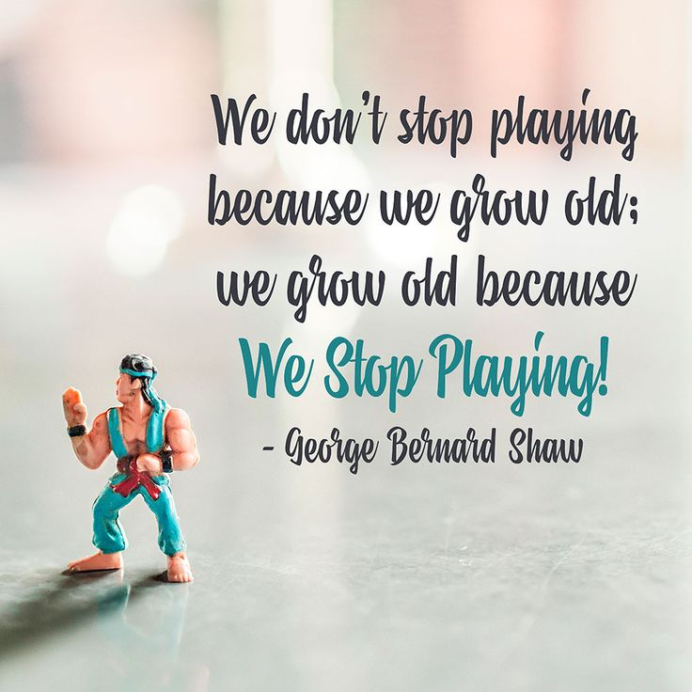

Continious provision
​
What is Continuous Provision?

Slide 2
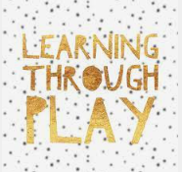
So…what is continuous provision?
Core range of staple resources available throughout the year.
High quality resources that are open ended and thought provoking.
Defined areas of learning in the classrooms.
Reflective of the current needs/ interests of the children and curriculum.
Child-led approach to learning
Enhancements….
Extra materials and resources that teachers or practitioners provide for their children that makes continuous provision more challenging/interesting.

Slide 3
What will it look like?
We plan to build upon the pedagogy and resources that we have in early years.
Relationships, Interactions and Well-Being are key. As well as following National Curriculum requirements and “The Hoo Way”
Teachers will teach inputs for subjects, followed by ‘tutor table’ which allows much smaller groupings of children for more accurate, high quality teaching. Children can immerse themselves in CP (Busy Time) during that time to practise, repeat and rehearse skills taught – solidifying learning.
More opportunities for more learning – not just what has been taught – no limit on learning.
Building resilience and independence ready for key stage two.

Slide 4
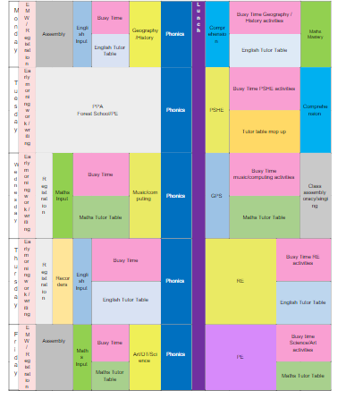

Slide 5
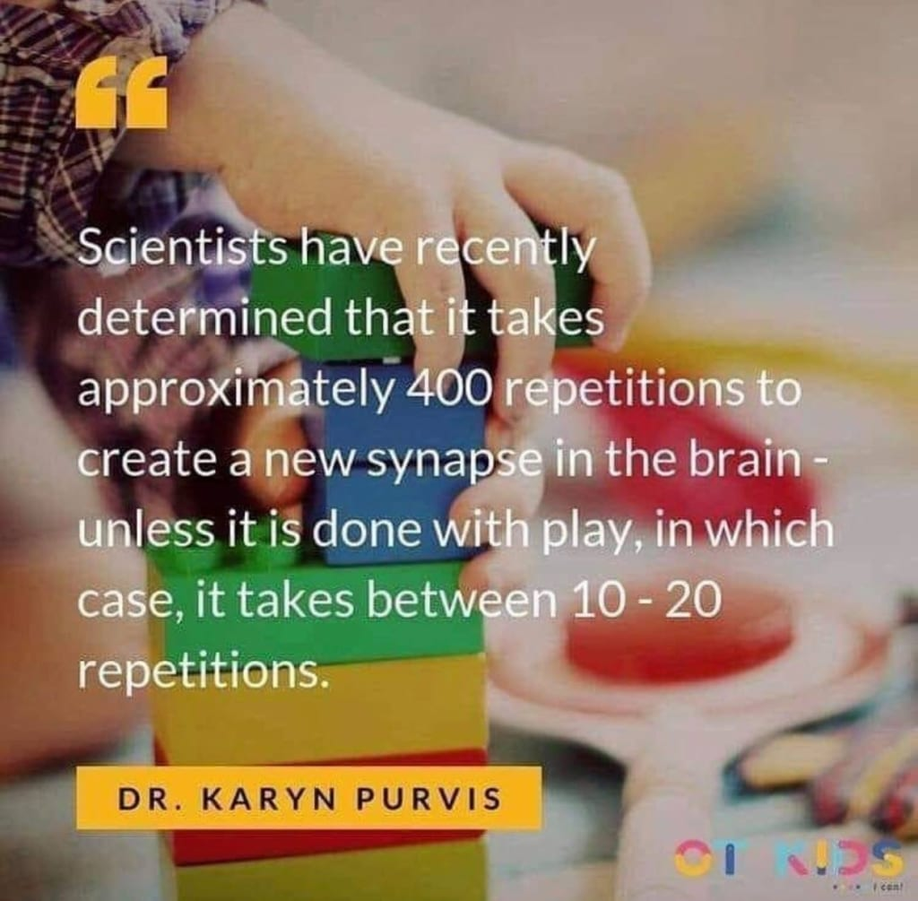
Why…
Our approach to teaching and learning is rooted in research and based on extensive knowledge of how children learn.
Children for the future
Children that can;
Solve problems
Create, make and build
Be active and healthy (children who spend more time outdoors are less poorly)
Come up with their own ideas, rather than be told ideas
Have a sense of freedom, growing up with a better idea of who they are
Be independent and use initiative
Think critically
Learn to make their own decisions
(28) How play helps child development - YouTube

Slide 6
Research…
Research and school experience tells us that young children 7 and under learn best through play.
What does the research on child development tell us?
Piaget (1952) describes four distinct periods of development, ranging from birth through to adulthood. The preoperational stage runs from 2 – 6 years and is the period during which children learn to use language, think symbolically, and represent their ideas using pictures and objects: they are highly active, learning through pretend play and first-hand experiences. It is not until around the age of 7 - 8 that major developmental changes take place; when children begin to think in the abstract (Bredekamp, 1987), develop the ability to plan ahead, to approach problems more logically and understand another’s point of view (Robinson, 2008).
The key question here then, is our practice developmentally appropriate? At Hoo – yes!

Slide 7
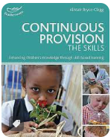
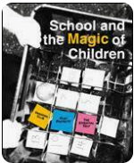
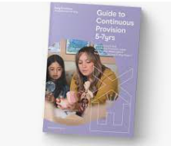
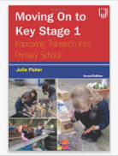
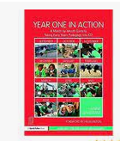
Finding out more…
(28) More Than A Score - Dr Pam Jarvis – YouTube
Continuous provision supports and encourages our children and staff to have
A lifelong love of learning.

Slide 8
Children that are happy and making progress

Slide 9
Let’s take a look…

